Slide 1
Dementia Risk Prediction with
Gaussian Process
Classification
Jazmine Haratani | DATASCI 224 | OASIS-2 Dataset

Slide 2
The Clinical Problem
Can we predict dementia from basic patient information alone —
and know how confident we are in that prediction?
Why it matters
Our approach: GPC
Dementia affects 55M+ people worldwide
Early detection enables intervention
Standard classifiers give predictions without confidence — risky in clinical settings
Non-parametric Bayesian classifier
Produces calibrated probabilities with honest uncertainty
Feature relevance built into the model via ARD kernel
Notes:
Rather than learning fixed parameters (log regression coefficients), GPC learns a distribution over possible decision boundaries
Why? Small to medium sample size, heterogenous predictors, calibrated uncertainty, no distributional assumptions (unlike LDA)
How? Using a kernel to measure covariance (variance for each patient’s features as well as compared to others), approximations for initial latent risk scores, probabilities reflecting uncertainty, confidence in results, and a predicted outcome class
The sample size allows GPC to avoid overfitting due to overparameterizing
The ability to measure how confident the model is = very important

Slide 3
Dataset: OASIS-2 Longitudinal
150
373
60–95
Binary
subjects
visits
age range (yrs)
CDR outcome
Predictor variables (X)
Outcome variable (y)
Age years, continuous
Clinical Dementia Rating (CDR)
Education (EDUC) years of schooling
CDR = 0
No dementia
SES socioeconomic status (1–5)
CDR = 0.5
Mild / questionable
Sex (M/F) binary encoded
CDR = 1+
Dementia
nWBV normalized whole brain volume
Binarized: CDR = 0 vs. CDR > 0
Notes:
Each patient has a set of features (Age, Education, SES, nWBV, Sex) and a known outcome CDR label

Slide 4


What is GPC — and why use it?
GP Prior
Posterior
Predictions
Distribution over functions
Learning from labels
Calibrated uncertainty
Rather than fixed parameters, GPC places a prior over all plausible latent risk functions. The kernel defines how similar patients should have similar risk scores.
Observed CDR labels update the prior via Bayes' rule. Because the likelihood is Bernoulli (binary outcome), the posterior is intractable — requiring the Laplace approximation.
Every prediction comes with a variance σ²∗. In sparse regions of the input space, the model hedges toward 0.5 rather than forcing a confident prediction.
GP Regression function:
$$f\left(x\right)\sim GP(m\left(x\right), k\left(x, x^{′}\right))$$
$f\left(x\right)$ = latent risk score
m(x) – mean function (usually 0)
k(x, x’) – our kernel with x, x’ being two inputs
GPC vs. Logistic Regression: LR gives confident predictions everywhere — GPC communicates honest uncertainty where data is sparse.
Notes:
Prior – what are the most plausible risk scores before seeing any data
Likelihood – how well do these scores explain the observed CDR labels?
Latent risk scores – peak of the posterior

Slide 5

Algorithm: Prior & Kernel
Covariance matrix K
Step 1 — Build the GP Prior
P1
P2
P3
P4
P5
For every pair of patients, compute kernel similarity k(xᵢ, xⱼ)
Patients with similar features (Age, nWBV, SES...) get high k values
Assemble into n×n covariance matrix K — this encodes prior belief
GP prior over latent risk scores: f ~ N(0, K)
P1
P2
P3
P4
ARD Kernel (one ℓ per feature):
P5
k(x, x’) = exp($\frac{\text{− }\text{Σ}\text{ (}xᵈ\text{ − }\text{x}\text{’ᵈ)²}}{\text{2ℓᵈ²}}$)
High similarity
Low similarity
Small ℓᵈ = feature is influential
Identical patients on diagonal = k = 1
Notes:
We take each patient and see how similar they are by features; using this comparison we build a matrix with “scores” associated with similarity between a pair of patients (the similarity matrix for our dataset)
Keep in mind that we use an optimizer to find the best length scales – essentially just climbing the log marginal likelihood surface with respect to length scales; its like adjusting this metaphorical dial to change the length scales until the kernel structure fits the data the best
Now this matrix is our GP prior – we are saying similar inputs (i.e. patient data) should have similar risk scores for CDR label = Demented
Our output here is our kernel that we will use in our GPC model function – keep in mind that the length-scales are also relaying information about the feature importance
Our length scales are a part of our optimized kernel – we initialize them before training and set them all to 1 as a starting point — but those initial values are just a starting guess, not the final values. The optimizer then adjusts them during fitting
we derive them by maximizing the log marginal likelihood (probability of observing the training labels y given the input features X and the kernel hyperparameters)
Basically asking - Which features, when I make the model sensitive to them, best explain why the patients who have dementia have CDR > 0 and the patients who don't have CDR = 0?

Slide 6
Algorithm: Laplace Approximation & Predictions
Step 2 — Approximate the Posterior (Laplace)
The problem
The solution
Prior (Gaussian) × Likelihood (Bernoulli) = Posterior with no closed form
Newton’s method climbs the log posterior to find the peak ƒ̂, then Laplace fits a Gaussian around it:
q(f|y) = N(ƒ̂, Σ)
Step 3 — Predict for a New Patient
Features
x∗
Kernel
weights
μ∗, σ²∗
P(CDR>0)
Age, nWBV,
SES, Educ, Sex
How similar is
this patient to
training data?
Predictive mean
& variance
sigmoid squash
with uncertainty
Large σ²∗ = model hedges toward 0.5 (honest uncertainty) | Small σ²∗ = confident, like logistic regression
Notes:
predictive mean is our predicted latent risk score which is ultimately from the kernel vector, the inverse of the training kernel, and the latent scores from Newton’s method
Predictive variance is computed by comparing the training data to the predicted patient’s input
Then we ask for any given latent risk score, how probable is it that it will match the CDR label observed (Bernoulli because outcome CDR label is binary) – this is our likelihood
Instead of usual approach multiplying the GP prior and Bernoulli likelihood to get our posterior, we use Newton’s method to find the most plausible set of latent risk scores for our patients, and wrap a Gaussian around that (LaPlace approx.) to find our posterior approximation
At any point f, we can compute the posterior and log posterior using our typical prior x likelihood formulas (likelihood - plug each f into the sigmoid function, compare to the known label y, get a number / prior - plug f into the multivariate Gaussian formula with covariance K, get a number)
We could use gradient ascent to find the f input that scores the highest log posterior, but its too slow – instead, Newton’s uses the curvature of the function (not only the slope) to find it in a smarter way
Newton’s method - iteratively re-weighted least squares (where the Hessian of the log-likelihood is diagonal (because the likelihood factorizes across data points)
Once we find the most plausible latent risk score – our peak, we fit a Gaussian using second-order Taylor expansion to provide a full distribution of uncertainty around it

Slide 7
Results: Model Performance & Feature Relevance
ARD Length-scales (smaller = more influential)
AUC-ROC
EDUC
0.667
Most influential
0.775
nWBV
1.064
±0.046 across 5 folds
Age
1.270
Moderate discrimination
5-fold stratified CV
Sex
2.631
SES
2.857
Interpretation: Education has the smallest length-scale, suggesting the model is most sensitive to variation in EDUC. nWBV follows closely. SES and Sex have large length-scales, contributing minimally once other features are accounted for. The AUC of 0.775 reflects moderate discrimination — consistent with using indirect demographic and structural features rather than direct cognitive measures.
Notes:
So the length-scale for each feature is literally just a dial that controls how much that feature gets to influence whether two patients are considered similar or not — and the optimizer turns those dials to whatever setting best explains your training data.

Slide 8
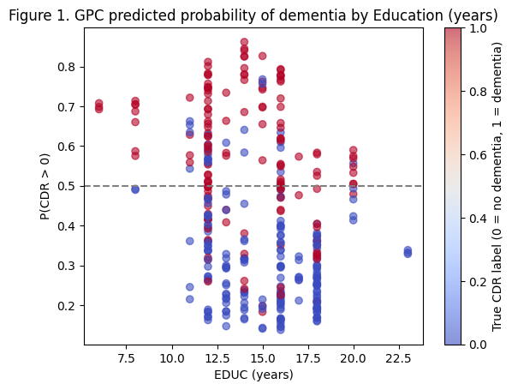
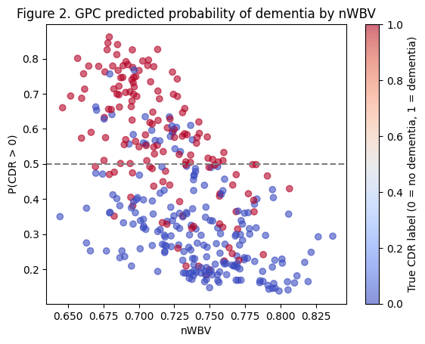
Results: Predicted Probability Plots
Figure 1
GPC Predicted P(CDR>0)
vs. EDUC
Figure 2
GPC Predicted P(CDR>0)
vs. nWBV
EDUC (Fig 1): Despite lowest length-scale, classes overlap substantially — no clean threshold separates dementia by education alone
nWBV (Fig 2): Clear left-to-right gradient — lower brain volume associated with higher P(CDR>0); overlap zone ~0.700–0.740 where GPC appropriately hedges
Contrast illustrates why multivariate modeling with ARD is needed — no single feature cleanly separates the classes
Notes:
0.5 is honest uncertainty like 50/50 probability

Slide 9
Why GPC? Uncertainty Matters Clinically
Scenario: patient with nWBV = 0.720, in the overlap zone
Logistic Regression
GPC
P(CDR > 0) = 0.61
P(CDR > 0) ≈ 0.54
vs
Confident prediction everywhere
No concept of sparse regions
Clinician reads: moderate evidence of dementia
Uncertainty σ²∗ pulls toward 0.5
Honest: “patient is in ambiguous zone”
Clinician reads: more information needed
In dementia screening, these are clinically different decisions — a model that communicates uncertainty is more informative than one that doesn’t.

Slide 10
Limitations & Conclusions
Limitations
Conclusions
Laplace approximation — uncertainty estimates carry error, especially in sparse regions; MCMC or Expectation Propagation would be more accurate at higher cost
Repeated measures treated as independent — OASIS-2 has longitudinal structure that GPC does not natively model
Small dataset — ~350 observations limits generalizability and cross-validation stability
Binary outcome — CDR binarization loses ordinal information
GPC achieved AUC = 0.775 using only demographic and structural features — moderate discrimination without direct cognitive measures
ARD length-scales identified EDUC and nWBV as most influential; SES and Sex contributed least
Calibrated uncertainty is GPC’s key advantage over logistic regression in a clinical screening context
GPC is not just about prediction accuracy — it is about knowing when not to be confident.

